Slide 1
When you create a new user using the CREATE USER statement with the ACCOUNT LOCK clause, the new user has a locked state.
Similarly, if you use the ALTER USER ACCOUNT LOCK statement to change a user account, the user account is also locked.

Slide 2
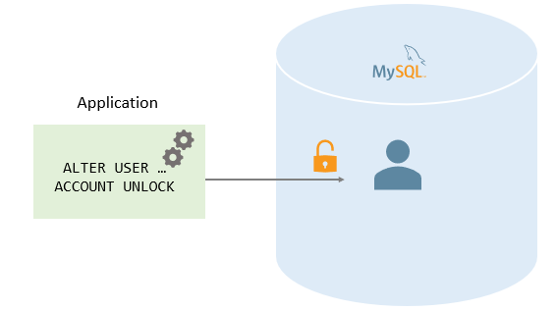

Slide 3
To unlock a user account, you use the ALTER USER ACCOUNT LOCK statement:
ALTER USER [IF EXISTS] account_name
ACCOUNT UNLOCK;
In this syntax:
First, specify the name of the user account that you want to unlock after the ALTER USER keywords.
Second, include the ACCOUNT UNLOCK clause after the account name.
Third, use the IF EXISTS option to conditionally unlock the account if it exists only.

Slide 4
To unlock multiple user accounts at the same time, you use the following syntax:
ALTER USER [IF EXISTS]
account_name1
[, account_name2, ...]
ACCOUNT UNLOCK;
In this syntax, you specify a list of comma-separated names of the user accounts that you want to unlock after the ALTER USER keywords.

Slide 5
Unlocking user accounts example
First, create a user named brad@localhost in a locked state:
CREATE USER brad@localhost
IDENTIFIED BY 'Secret!pass1'
ACCOUNT LOCK;

Slide 6

Second, show the status of the user account:
SELECT
user,
host,
account_locked
FROM
mysql.user
WHERE
user = 'brad' AND
host = 'localhost';

Slide 7
Third, use the ALTER USER to unlock the user:
ALTER USER 'brad'@'localhost'
ACCOUNT UNLOCK;

Slide 8
Thank You
Please Subscribe My Channel
https://www.youtube.com/channel/UCYW3PWPOPn3qgxxjhUbXXXg?view_as=subscriber

